Slide 1
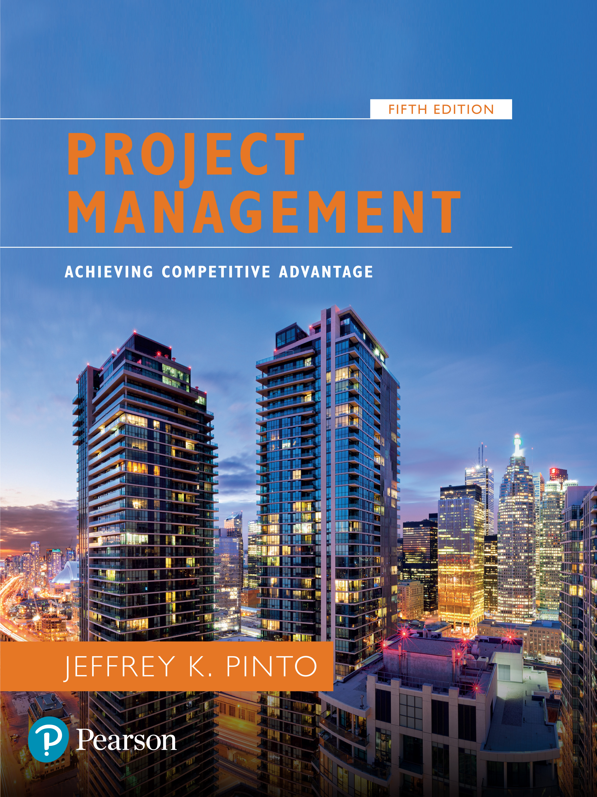
Project Management: Achieving Competitive Advantage
Fifth Edition
Chapter 2
The Organizational Context: Strategy, Structure, and Culture
Copyright © 2019, 2016, 2013 Pearson Education, Inc. All Rights Reserved
Notes:
If this PowerPoint presentation contains mathematical equations, you may need to check that your computer has the following installed:
1) MathType Plugin
2) Math Player (free versions available)
3) NVDA Reader (free versions available)

Slide 2
Outline
Strategy
Environmental Analysis
Stakeholder Analysis
Organizational Structure
Project Management Office
Organizational Culture

Slide 3
Projects and Organizational Strategy
Strategic management—the science of formulating, implementing, and evaluating cross-functional decisions that enable an organization to achieve its objectives.
Consists of:
Developing vision and mission statements
Making cross-functional decisions
Achieving objectives

Slide 4
Strategy
…a plan of action designed to achieve a long-term or overall aim…
Identify you main aim and decide on specific actions that would be required to achieve those aims.
Some marketing strategies: market penetration, niche marketing, geographic segmentation etc.
These are specific strategies that the marketing department can employ to achieve overall organisational goals.
How would projects fit into these?

Slide 5
Table 2.1 Projects Reflect Strategy
Strategy | Project
Technical or operating initiatives (such as new distribution strategies or decentralized plant operations) | Construction of new plants or modernization of facilities
Development of products for greater market penetration and acceptance | New product development projects
New business processes for greater streamlining and efficiency | Reengineering projects
Changes in strategic direction or product portfolio reconfiguration | New product lines
Creation of new strategic alliances | Negotiation with supply chain members (including suppliers and distributors)
Matching or improving on competitors’ products and services | Reverse engineering projects
Improvement of cross-organizational communication and efficiency in supply chain relationships | Enterprise I T efforts
Promotion of cross-functional interaction, streamlining of new product or service introduction, and improvement of departmental coordination | Concurrent engineering projects

Slide 6
Environmental Analysis
… is a strategic tool. It is a process to identify all the external and internal elements, which can affect the organization's performance. The analysis entails assessing the level of threat or opportunity that may affect an organisation.
One basic tool for conducting this is the SWOT Analysis.
Strength
Weakness
Opportunity
Threat

Slide 7
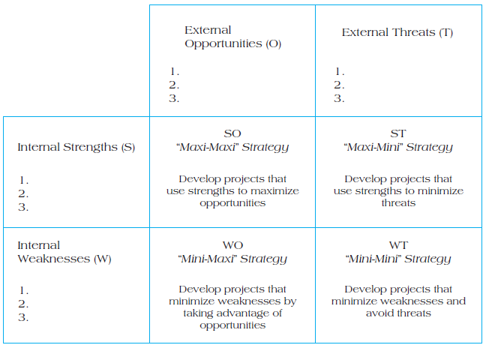
Figure 2.2 T O W S Matrix

Slide 8
Class Assignment
Develop a TOWS Matrix for an organisation of your choice. Use at least three factors each from the environmental analysis. (5marks)

Slide 9
Stakeholder Management
Stakeholder analysis is a useful tool for demonstrating some of the seemingly irresolvable conflicts that occur through the planned creation and introduction of new projects.
Project stakeholders are defined as all individuals or groups who have an active stake in the project and can potentially impact, either positively or negatively, its development.

Slide 10
Identifying Project Stakeholders
Internal Stakeholders
Top management
Accountant
Other functional managers
Project team members
External Stakeholders
Clients
Competitors
Suppliers
Environmental, political, consumer, and other intervener groups

Slide 11
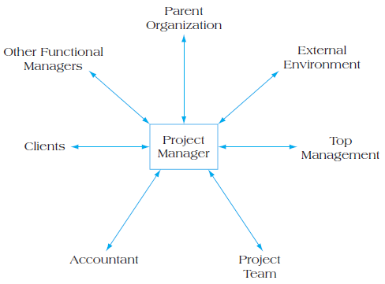
Figure 2.3 Project Stakeholder Relationships

Slide 12
Managing Stakeholders
Assess the environment.
Identify the goals of the principal actors.
Assess your own capabilities.
Define the problem.
Develop solutions.
Test and refine the solutions.

Slide 13
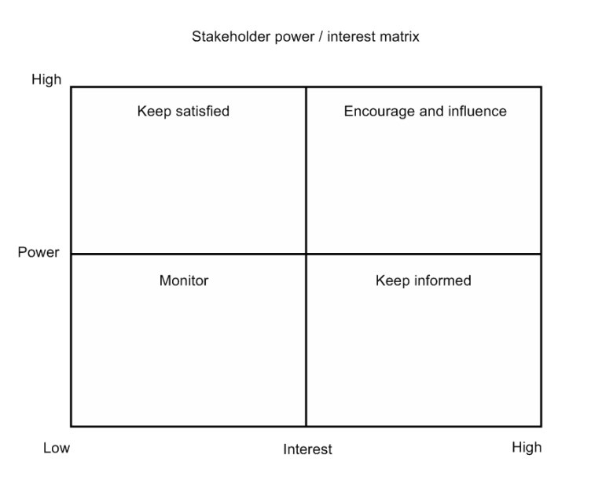
Managing Stakeholders

Slide 14
Class Assignment
Using the list of Stakeholders provided, construct a stakeholders’ management matrix

Slide 15
Organizational Structure
Consists of three key elements:
Designates formal reporting relationships
number of levels in the hierarchy
span of control
Identifies groupings of
individuals into departments
departments into the total organization
Design of systems to ensure
effective communication
coordination
integration across departments

Slide 16
Forms of Organization Structure
Functional organizations—group people performing similar activities into departments
Project organizations—group people into project teams on temporary assignments
Matrix organizations—create a dual hierarchy in which functions and projects have equal prominence

Slide 17
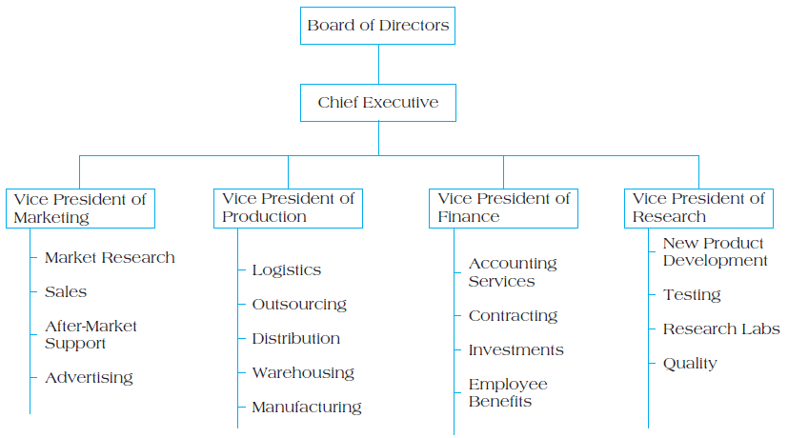
Figure 2.4 Example of a Functional Organizational Structure

Slide 18
Table 2.2 Strengths and Weaknesses of Functional Structures
Strengths for Project Management | Weaknesses for Project Management
1. Projects developed within basic functional structure require no disruption or change to firm’s design. | 1. Functional siloing makes it difficult to achieve cross-functional cooperation.
2. Enables development of in-depth knowledge and intellectual capital. | 2. Lack of customer focus.
3. Allows for standard career paths. | 3. Longer time to complete projects.
Blank | 4. Varying interest or commitment.

Slide 19
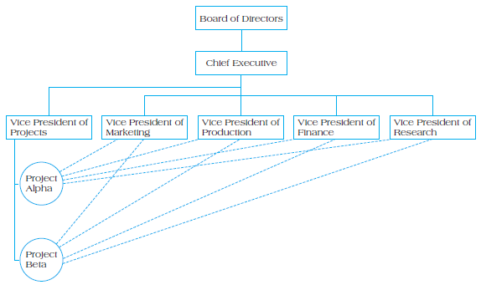
Figure 2.6 Example of a Project Organizational Structure

Slide 20
Table 2.3 Strengths and Weaknesses of Project Structures
Strengths for Project Management | Weaknesses for Project Management
1. Project manager sole authority | 1. Expensive to set up and maintain teams
2. Improved communication | 2. Chance of loyalty to the project rather than the firm
3. Effective decision making | 3. Difficult to maintain a pooled supply of intellectual capital
4. Creation of project management experts | 4. Team member concern about future once project ends
5. Rapid response to market opportunities | Blank

Slide 21
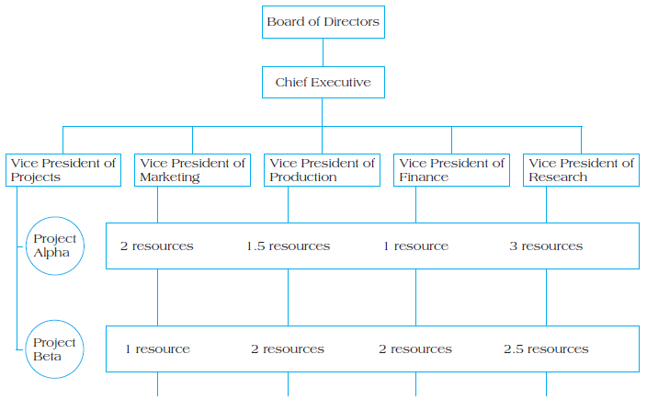
Figure 2.7 Example of a Matrix Organizational Structure

Slide 22
Table 2.4 Strengths and Weaknesses of Matrix Structures
Strengths for Project Management | Weaknesses for Project Management
1. Suited to dynamic environments | 1. Dual hierarchies mean two bosses
2. Equal emphasis on project management and functional efficiency | 2. Negotiation required in order to share resources
3. Promotes coordination across functional units | 3. Workers caught between competing project and functional demands
4. Maximizes scarce resources | Blank

Slide 23
Heavyweight Project Organizations
Organizations can sometimes gain tremendous benefit from creating a fully dedicated project organization.
Lockheed Corporation’s “Skunkworks”
Project manager authority expanded
Functional alignment abandoned in favor of market opportunism
Focus on external customer

Slide 24
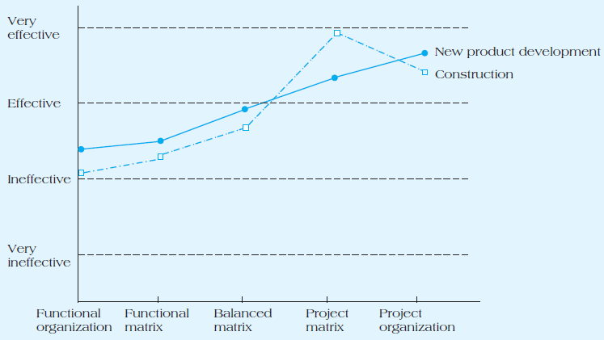
Figure 2.8 Managers’ Perceptions of Effectiveness of Various Structures on Project Success

Slide 25
Project Management Offices
Centralized units that oversee or improve the management of projects
Resource centers for:
Technical details
Expertise
Repository
Center for excellence

Slide 26
Forms of P M O s and Control
Three forms of P M O s, varying with degrees of control and influence include:
Supportive—low control; consultative and provide P M resources and training
Controlling—moderate control; requires compliance to adopted P M standards/processes
Directive—high control; directly manages projects

Slide 27
Models of P M O s

Slide 28
Organizational Culture
Unwritten
Rules of behavior
Held by some subset of the organization
Taught to all new members

Slide 29
Key Factors That Affect Culture Development
Technology
Environment
Geographical location
Reward systems
Rules and procedures
Key organizational members
Critical incidents

Slide 30
Organizational Culture: Effects on Project Management
Departmental interaction
Employee commitment to goals
Project planning
Performance evaluation

Slide 31
Thank You

